Slide 1
Chapter 11 Secure systems development
E.B.Fernandez

Slide 2
Microsoft touts new, holistic approach to enterprise security http://www.networkworld.com/article/3005621/microsoft-touts-new-holistic-approach-to-enterprise-security.html?phint=newt%3Dnetworkworld_security_alert&phint=idg_eid%3Dc30d380502694c47d2c45cb7576fbd6b#tk.NWWNLE_nlt_security_2015-11-19
Microsoft is putting a lot of effort and money into building a holistic security platform that combines the attack protection, detection and response features built into Windows 10, Office 365, Azure and the Microsoft Enterprise Mobility Suite to help companies safeguard their data regardless of where it resides.
Talking at the Microsoft Government Cloud Forum in Washington, D.C., Tuesday, Microsoft CEO Satya Nadella said that the company is spending more than $1 billion a year in research and development to build security into its products, because "security has to be core to the operational systems used by enterprises.“
The company showed on stage how Windows 10’s Microsoft Passport, Windows Hello and Credential Guard provide secure authentication and integrate with Azure Active Directory; how Advanced Threat Analytics can detect anomalous login patterns, brute-force and pass-the-hash attacks; and how the Enterprise Mobility Suite (EMS) can be used to manage data and applications on mobile devices and work with Microsoft Intune and Azure Rights Management Services (RMS) to prevent accidental data leaks.

Slide 3
Dell admits installing security hole on laptops, apologizes, offers fix http://www.networkworld.com/article/3008078/security/dell-admits-installing-security-hole-on-laptops-apologizes-offers-fix.html?phint=newt%3Dnetworkworld_daily_news_alert&phint=idg_eid%3Dc30d380502694c47d2c45cb7576fbd6b#tk.NWWNLE_nlt_daily_am_2015-11-24
Dell acknowledges a root certificate it installed on its laptops was a bad idea and is pushing a patch to permanently remove it.
The eDellRoot was installed as a support tool to make it faster and easier for customers to service the devices. But some of those customers discovered the certificate and recognized it as a serious security threat.
The problem, according to a Dell customer who discovered it, programmer Kevin Hicks, is that the certificate could be used to sign malicious code, certifying that it is safe to install when it’s not.
“A network attacker could use this CA to sign his own fake certificates for use on real websites and an affected Dell user would be none the wiser unless they happened to check the website's certificate chain.”
Hicks and others who discovered eDellRoot say its potential impact was similar to that of Superfish, the adware that was installed on new Lenovo computers earlier this year. It proxied HTTPS connections to Web sites, making it a potential spot for attackers to perform man-in-the-middle attacks against the affected machines.

Slide 4
The design of secure systems
We not only have to satisfy functional specs but nonfunctional specs.
Security is a nonfunctional aspect
We cannot show absence of security flaws
We must use good development methods and test the system security
Security must be applied in the whole lifecycle and the complete system

Slide 5
Security principles
Holistic approach--Cover all architectural levels and all units
Highest level—security constraints must be defined where their semantics are clear and propagated down
Full mediation—every request for resources must be authorized
Defense in depth—have more than one line of defense
Closed system—Everything is forbidden unless explicitly authorized
Need-to-know—Assign only the necessary rights to perform functions
Economy of mechanism
Fail-safe defaults
Complete mediation
Open design
Separation of privilege
Least privilege
Least common mechanism

Slide 6
Security principles for application design
Security constraints must be defined at the highest layer, where their semantics are clear, and propagated to the lower levels, which enforce them.
All the layers of the architecture must be secure.
We can define patterns at all levels. This allows a designer to make sure that all levels are secured, and also makes easier propagating down the high-level constraints.
We must apply security at all development stages (tactic-based approaches start from design)

Slide 7
More principles
Compartments—Divide application in isolated compartments with well-defined interfaces
Submarine—If a compartment is compromised, others can survive, e.g. HP’s Virtual Vault
Compartments with different degrees of security—some compartments are better protected than others, i.e., we do not need to protect all compartments equally. This is used in reliable systems.

Slide 8
Trusted Computing Base
We want to trust as little of the system as possible (another principle)
Security Kernel: includes all security-related functions
Verification: possible only for relatively simple systems, e.g. L4
Requires special languages and special operating systems for larger systems
Not practical for general systems but every system must have a TCB

Slide 9
Use of kernels
DBMS
DBMS Kernel
Sec. Kernel
OS
Kernel

Slide 10
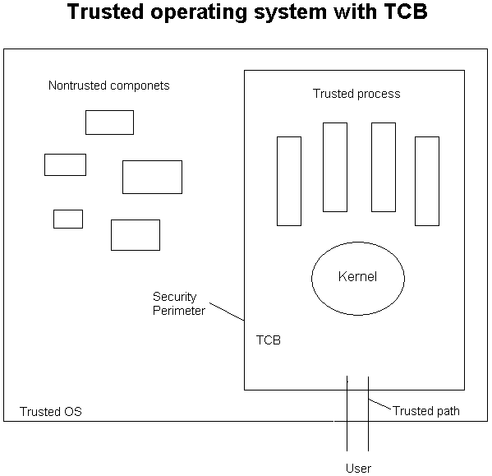

Slide 11
A methodology for secure architectures
Stages
Financial institution example

Slide 12
Secure systems development methodology
Apply security principles throughout the whole software lifecycle
Use of object-oriented design and RBAC
Use cases define rights for roles
Patterns build a secure conceptual model
Multilayer architecture extends the model to the lower architectural levels

Slide 13
Use patterns at all levels
Patterns for models define the highest level
At each lower level we refine the model patterns to consider the specific aspects of each level
Patterns for file systems, web documents, cryptography, distributed objects, J2EE components

Slide 14
Value of security patterns
Can describe security principles (Single Point of Access) or security mechanisms (Firewalls)
Can guide the design and implementation of the security mechanism itself
Can guide the use of security mechanisms in an application (stop specific threats)
Can help understanding and use of complex standards (XACML, WiMax)
Good for teaching security principles and mechanisms

Slide 15
Secure lifecycle

Slide 16
How to apply the patterns?
A good catalog and classifications of patterns help a designer select among alternatives.
However, there is still the problem of when to apply a pattern during system development
We need some systematic approach to decide when we need to use a pattern, a secure systems methodology

Slide 17
A methodology for secure systems design I
Domain analysis stage: A business model is defined. Legacy systems are identified and their security implications analyzed. Institution policies and regulations must be defined in this phase.
Requirements stage: Use cases define the required interactions with the system. Applying the principle that security must start from the highest levels, it makes sense to relate attacks to use cases. We study each action within a use case and see which threats are possible. We then determine which policies would stop these attacks. From the use cases we can also determine the needed rights for each actor and thus apply a need-to-know policy.

Slide 18
Requirements stage
Use cases are determined
Activity diagrams for use cases or sequences of use cases
Define level of security needed
Identify attacks
Select attacks based on risk analysis

Slide 19
Identifying threats
We need to know what kind of attacks to expect.
We relate threats to attacker goals
We study systematically all the possible threats to each activity in a use case
Use cases define all functional interactions

Slide 20
Attacker goals
The Attacker is not interested in changing a few bits or destroying a message
The Attacker wants to accomplish some objective, e.g., steal money, steal identity
This is applying the principle of defining security at the semantic levels
We also need to comply with standards

Slide 24
Threats
T1.The customer is an impostor and opens an account in the name of another person
T2.The customer provides false information and opens an spurious account
T3.The manager is an impostor and collects data illegally
T4.The manager collects customer information to use illegally
T5.The manager creates a spurious account with the customer’s information
T6.The manager creates a spurious authorization card to access the account
T7.An attacker tries to prevent the customers to access their accounts
T8.An attacker tries to move money from an account to her own account

Slide 25
Analysis stage
Analysis patterns can be used to build the conceptual model. Security patterns describe security models or mechanisms. We can build a conceptual model where repeated applications of a security model pattern realize the rights determined from use cases.

Slide 26
Use case analysis leads to policies
T1. T3. Mutual authentication. Every interaction across system nodes is authenticated.
T2. Verify source of information.
T4. Logging. Since the manager is using his legitimate rights we can only log his actions for auditing at a later time.
T5. T6. Separation of administration from use of data. For example, a manager can create accounts but should have no rights to withdraw or deposit in the account.
T7. Protection against denial of service. We need some redundancy in the system to increase its availability.
T8. Authorization. If the user is not explicitly authorized he should not be able to move money from any account.
Policies can be realized with patterns

Slide 27
Use cases can also be used to find actor rights (authorization rules)
Use cases describe all possible uses of the system
All use cases define all possible and legal accesses
Each actor can be given its needed rights to perform its functions

Slide 29
Role rights for financial institution
Customers can open/close accounts
Customers can initiate trade
Broker can perform trade
Auditor can inspect (read) trade transactions

Slide 31
Adding more security: authentication, logging, separation of duty
openAcct
closeAcct
Not as Acct
User Role
MRight
…
1
Manager
*
…
Account
*
*
Acct User Role
*
Transaction
*
*
log
1
1
Authenticator
Logger
1

Slide 32
Methodology summary
Use case activities define threats
Threats must be stopped or mitigated by applying policies
Use cases define needed actor rights
Access matrix or RBAC models formalize these rights
We get a secure conceptual model

Slide 34
Security is applied along the distribution path
Proxies and adapters apply authorization (Customer access to Accounts)
Proxies and adapters apply authentication (Branch office and central office mutual authentication)
Logging can be applied in the Transaction view (not shown)
Broker communications can be encrypted
Messages from Customers for trade can be signed

Slide 35
Implementation stage
Requires reflecting in the code the security rules defined in the design stage.
Because these rules are expressed as classes, associations, and constraints, they can be implemented as classes in object-oriented languages.
In this stage we can also select specific security packages or COTS components, e.g., a firewall product, a cryptographic package
Some of the patterns identified earlier in the cycle can be replaced by COTS components (these can be tested to see if they include a similar pattern).

Slide 36
J2EE, .NET
Web Services
REST Services
code
Functional
Classes
Security/Reliability
COTS components
NFR
Classes

Slide 37
Deployment for financial institution
firewalls
VPN
Customers
authorization
.
Web Server
Web Application
Server
.
Internet
.
certificates
IDS
Databases
message
encryption
certificates
ATMs,
Browsers
authorization
encryption
Brokers
Auditors

Slide 39
A Comprehensive Pattern-Driven Security Methodology for Distributed Systems
Anton V. Uzunov^{1, *}, Eduardo B. Fernandez² and Katrina Falkner¹
¹ School of Computer Science, The University of Adelaide, Adelaide, SA 5005, Australia ;
e-mail: {anton.uzunov, katrina.falkner}@adelaide.edu.au
* Currently at the Defence Science and Technology Organisation (DSTO),
Cyber & EW Division, Edinburgh, South Australia
e-mail: anton.uzunov@dsto.defence.gov.au
² Department of Computer Science and Engineering, Florida Atlantic University, Boca Raton, FL 33431, USA ;
e-mail: fernande@fau.edu

Slide 40
Agenda
Security methodologies: motivation
ASE: a comprehensive security methodology
Summary and future work

Slide 41
What is a security methodology?
Methodology: systematic way of doing something
Security methodology:
systematic way of introducing security into a software system during the development life-cycle
Advantages analogous to those of software engineering process vs. ad-hoc development
Partial or comprehensive; covering early phases of the development life-cycle especially important
Consists of two aspects/facets: security process (SP) and conceptual security framework (CF)
Can be specific (e.g. Web services) or generic

Slide 42

ASE: a comprehensive security methodology for distributed systems
Many methodologies exist with different paradigms
Very important class is methodologies that use security patterns
ASE: a security methodology using patterns and related constructs designed specifically for general distributed systems

Slide 43

Major elements of CF: Decomposition Framework
A 3 level framework for decomposing distributed software architectures
High-level modeling asbtractions – consistent concepts
Functionality decomposition layers – isolation
Technical realization abstractions – detail

Slide 44

Major elements of CF: Security patterns and security solution frames
Security patterns are software patterns that encapsulate successful security designs
Can be simple or compound
Security solution frames encapsulate and organize security patterns into different levels of abstraction (vertically) and different facets of a root security policy (horizontrally)

Slide 45
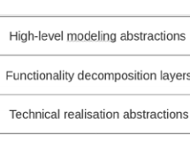
Framework for distributed systems

Slide 46
Security solution frames (SSFs)
SSFs are solution structures that encapsulate and organize security patterns; they realize security requirements.
SSFs can facilitate the work of designers by collecting together all the relevant patterns to realize some security requirements, guiding the designer from an abstract conceptual level to a concrete implementation-oriented level.

Slide 47
SSF structure
SSFs define horizontal and vertical pattern structures.
Horizontal structures, Security Pattern Families(SPFs), correspond to peer-related patterns that complement each other and define different facets of a security policy, while vertical structures are hierarchies of patterns specialized going from ASPs to practical implementations.
ASPs can be used to characterize SSFs and act as roots of these hierarchies, where each lower level is a pattern specialized for some specific context.
For example, a SSF for Authentication includes (among others) a family of Authentication patterns, which in turn includes Application-driven Authentication, Authentication Server, Password-based Authentication, and others.

Slide 48
SSF: Authentication hierarchy

Slide 49
List of SSFs
Security solution frame | Description and security tactics realized
Authorization | Encapsulates security patterns allowing for custom conceptual authorization models to be built and realized using different enforcement architectures [22]. Tactic realized: Authorize Users.
Identity management | Encapsulates patterns concerned with managing (assigning, establishing, validating) identities of users and/or processes in a distributed system (partially in [23]). Tactic realized: Authenticate Users.
Secure communication | Encapsulates security patterns for enabling two or more parties to communicate securely over a message channel [23]. Tactics realized: Protect Communications (Maintain Data Confidentiality & Maintain Integrity in a communications context).
Filtering (*) | Shall encapsulate patterns for network- and application-level filtering of information, including firewalls and custom data filters. Tactic realized: Limit Exposure.
Storage security (*) | Shall encapsulate patterns for secure storage of information, including patterns for storing passwords, information dispersal, database security and others. Tactics realized: Keep Data Secure (Maintain Data Confidentiality & Maintain Integrity in a storage context).
Logging and monitoring (*) | Shall encapsulate patterns for logging and monitoring events in a distributed system, ranging from creating simple log files to the deployment of intrusion-detection systems (network monitoring). Tactics realized: Intrusion Detection & Audit Trail.
Execution control (*) | Shall encapsulate patterns for controlling and managing the execution of processes or, more generally, execution abstractions in a distributed system, including for process serialization / concurrency management, safe handling of mobile code, process isolation, improved resource availability and others. Tactics realized: Limit Access & Safeguard Process (*).
Security information management | Encapsulates patterns concerned with the management of security information such as policies, credentials, cryptographic keys etc. (partially in [23] and in [22]). Tactic realized: Manage Security Information.

Slide 50
Abstract Security Patterns
An ASP is a security pattern that describes a conceptual semantic restriction in a domain which can be a defense to a threat or a way to comply with a regulation, with no implementation aspects.
An ASP describes the essential functions that must be present to handle a threat or regulation in an implementation-independent way.
For example this is the Intent section of an Authenticator pattern: “When a user or system (subject) identifies itself to the system, how do we verify that the subject intending to access the system is who it says it is? Present some information that is recognized by the system as identifying this subject. Once recognized, the subject receives a token as proof.”

Slide 51
Abstract Authenticator

Slide 52
Security solution frames (SSFs)

Slide 53

Major elements of CF: Threat taxonomies/libraries
Threat taxonomies/libraries consist of threat patterns, which can be customized and instantiated in different architectural contexts to define specific threats to a system.
Allow developers to quickly and efficiently consider a range of relevant threats during threat modeling.

Slide 54
Threat classes
Functionality decomposition layer | Relevant threat classes
User interaction | Identity attacks, Passing illegal data, Remote information inference, Repudiation, Uncontrolled operations
Data / storage management | Passing illegal data, Stored data attacks, Remote information inference, Uncontrolled operations
Resource management | Uncontrolled operations
Distribution control | Identity attacks, Passing illegal data, Remote information inference, Uncontrolled operations
Communication | Network communication attacks, Network protocol attacks, Repudiation
Addressing | Network communication attacks, Network protocol attacks, Repudiation

Slide 55
Second level process patterns
Security process pattern | Shorthand name | Gr | Intent
Security Requirements Determination | SecReq | P | Specify both prescriptive and resultant security requirements for the target system.
Countermeasure Introduction | CounterIntro | P | Introduce security countermeasures by converting problem-space requirements into solution-space goals and policies, and incorporating these into relevant models of the target system.
Security Implementation | SecImpl | P | Transfer the security-related (standalone or enriched functional) models into concrete software units.
Security Administration | SecAdmin | P | Configure all component parts of the (implemented) security infrastructure, setting appropriate policies for the individual controls.
Adversary Modeling | AdvMod | S | Model attackers and their potential attacks (e.g. in the form of threats) to a system.
Countermeasure Identification | CounterIdentif | S | Map problem-space security requirements to solution-space abstractions.
Security Modeling | SecMod | S | Incorporate security countermeasures (e.g. via the application of security patterns, security aspects etc.) as appropriate representations into a system's models.
Security Verification | SecVerif | S | Verify that the introduced constructs (design, code etc.) provide the necessary level of security and adequately protect the system against relevant threats.
Coding | Cod | S | Implement security countermeasures as concrete software subsystems in conjunction with the functionality of the whole system via manual coding.
Structured countermeasure identification | structured | T | Use a systematic approach to maps requirements to well-known sets of security solutions/countermeasures.
Instantiation | instantiate | T | Instantiate countermeasures into relevant architectural models.
Modeling | model | T | Model countermeasures directly as part of a system's (functional) architecture.
Semi-automated verification | semi-automated | T | Use tool-support to help verify some of the models or code excerpts.
Attack scenarios | attacks | T | Determine a set of attacks or scenarios that can be used to analyze any security-enhanced models.
Refinement | refine | T | Perform the same activity at a finer level of granularity, introducing new or variant strategies, or improving upon previous consequences/results.

Slide 56
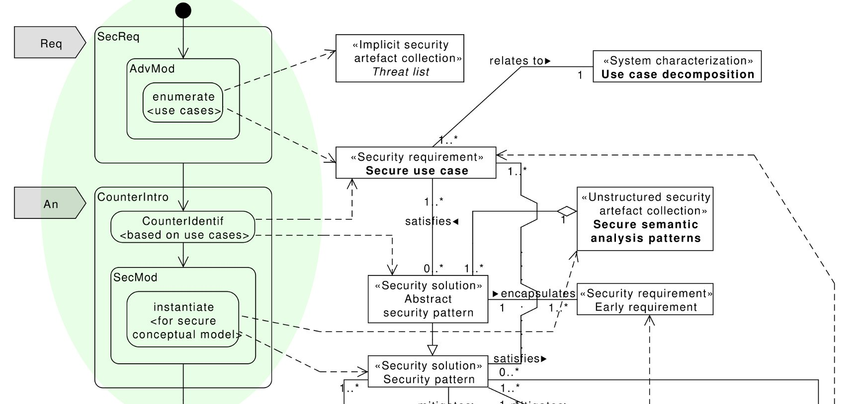
ASE security process overview: Requirements Analysis phase

Slide 57
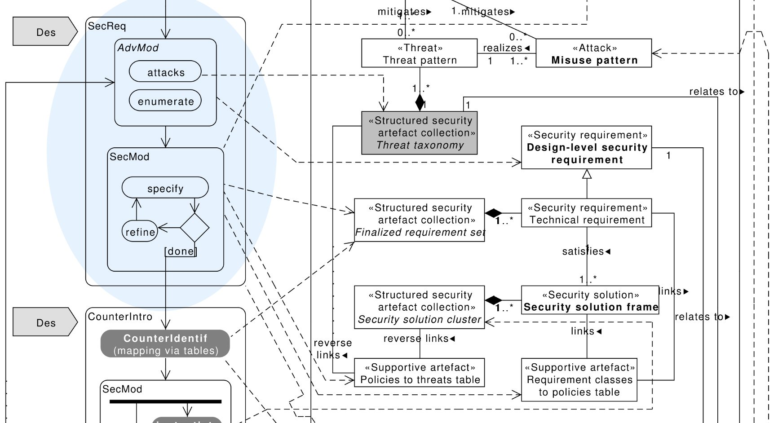
ASE security process overview: Design phase (1/2)

Slide 58
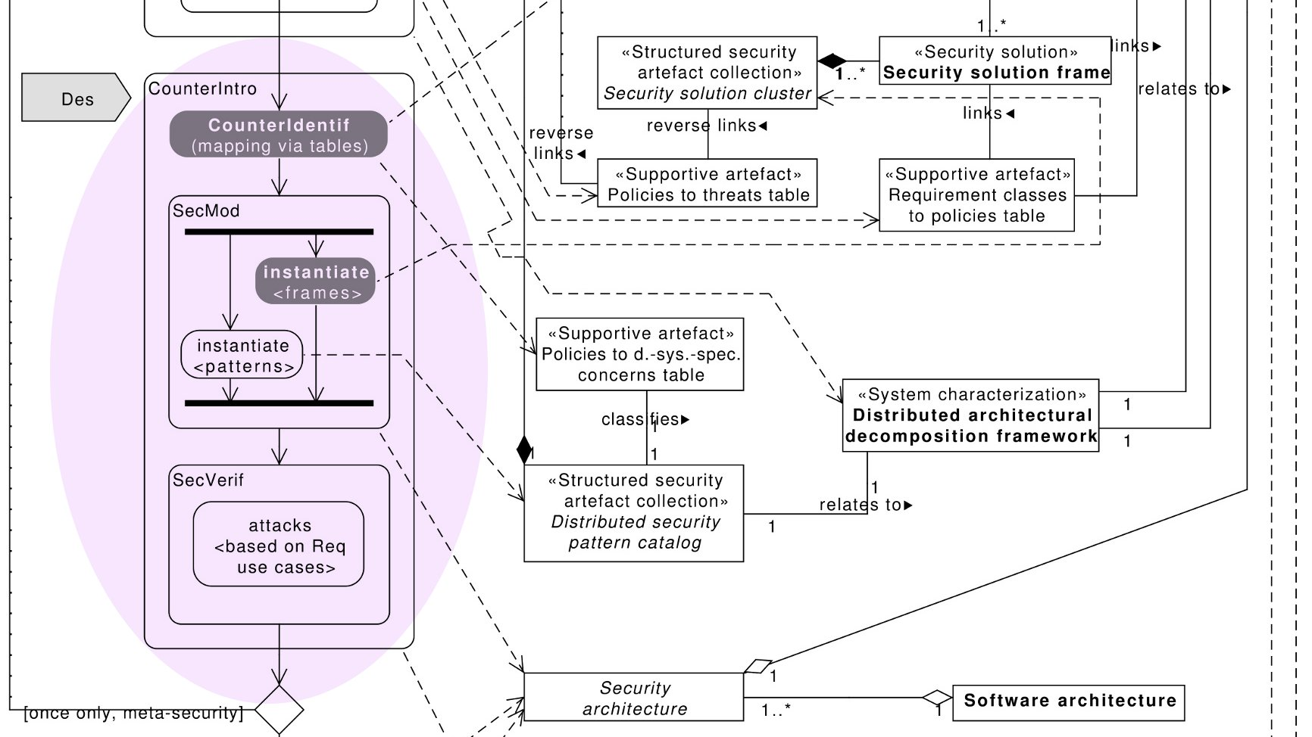
ASE security process overview: Design phase (2/2)

Slide 59
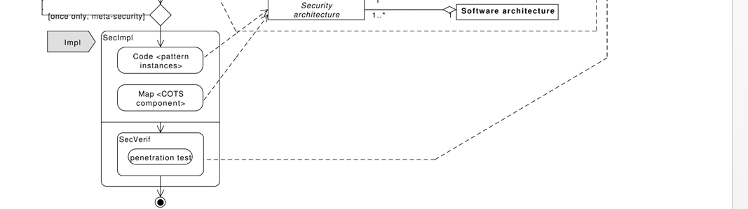
Implementation phase

Slide 60
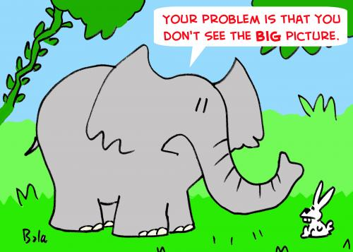

Summary and future directions
This presentation: outlined ASE, a pattern-based security methodology designed specifically for general distributed systems

Slide 61
Future work (ideas for theses)
Apply methodology to cyber-physical systems (two proposals sent)
Cloud ecosystems, including fog computing
Write more security, threat, and misuse patterns
Build complete SSFs (we have two now, semi-complete)
Further evaluation of the methodology
Measuring (qualitatively) security
Twin peaks development (Takao Okubo, Japan)

Slide 62
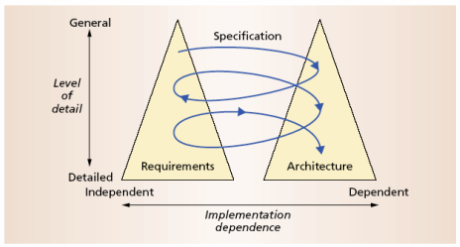
The Twin Peaks Model
Bashar Nuseibeh

Slide 63
References
Anton Uzunov, Eduardo B Fernandez, Katrina Falkner, ASE: A Comprehensive Pattern-Driven Security Methodology for Distributed Systems. To appear in Journal of Computer Standards & Interfaces
Anton Uzunov, E. B Fernandez, Katrina Falkner, “Security solution frames and security patterns for authorization in distributed, collaborative systems”, Computers & Security, 55, 2015, pp. 193-234, doi: 10.1016/j.cose.2015.08.003 (ISI)
A.Uzunov and E.B.Fernandez, “An Extensible Pattern-based Library and Taxonomy of Security Threats for Distributed Systems”- Special Issue on Security in Information Systems of the Journal of Computer Standards & Interfaces. 2013. http://dx.doi.org/10.1016/j.csi.2013.12.008
Anton Uzunov, E. B Fernandez, Katrina Falkner, “ASE: A Comprehensive Pattern- Driven Security Methodology for Distributed Systems”, Journal of Computer Standards & Interfaces , Volume 41, September 2015, Pages 112-137, http://www.sciencedirect.com/science/article/pii/S0920548915000276 (SCOPUS)
E.B.Fernandez, “Security patterns in practice: Building secure architectures using software patterns”, Wiley Series on Software Design Patterns, 2013.
E. B.Fernandez, Nobukazu Yoshioka, Hironori Washizaki, and Joseph Yoder, "Abstract security patterns for requirements specification and analysis of secure systems'', Procs. of the WER 2014 conference, a track of the 17th Ibero-American Conf. on Soft. Eng.(CIbSE 2014), Pucon, Chile, April 2014
E.B.Fernandez, Raul Monge, and Keiko Hashizume, “Building a security reference architecture for cloud systems”, Requirements Engineering. Doi: 10.1007/s00766-014-0218-7, 2015 (ISI)

Slide 64
Assignment 3: Write a misuse pattern for Stuxnet. Describe only sections Intent, Solution, Known Uses, and References
Intent (thumbnail of the problem it solves and a brief description of how it solves the problem)
Targeting industrial control systems used in gas pipelines or power plants
To reprogram by modifying control on program logic controllers, and hiding these changes from the operator and the equipment
To ultimately sabotage these systems and have them perform how the hijackers wished instead of how they were programmed to perform
Solution (section should describe the idea of the pattern. How the worm/virus works)
Attack industrial components vendors, as a way to introduce Stuxnet worm to target insolated industrial networks. Once the worm is brought into the industrial network, infect Microsoft Windows OS machines by exploiting zero day vulnerabilities. Use a link file to propagate copies of the worm across the network, scanning for Siemens Step 7 SCADA software, and PLCs running control logic. A rootkit component hides all malicious files and processes, preventing detection. In absence of either criterion, Stuxnet becomes dormant inside the computer. If both conditions are fulfilled, Stuxnet introduces the infected code onto the PLCs and the Siemens Step 7 SCADA software, modifying the logic and its configuration, giving invalid/out of limits commands to the industrial equipment while sending normal operation values to operators and users. Causing failure, disruption or destruction of physical equipment and industrial control processes.
Known uses (examples of its use in real systems)
Duqu and Flame are variants of Stuxnet
References
http://spectrum.ieee.org/telecom/security/the-real-story-of-stuxnet
http://www.cs.arizona.edu/~collberg/Teaching/466-566/2012/Resources/presentations/2012/topic9-final/report.pdf

Slide 65
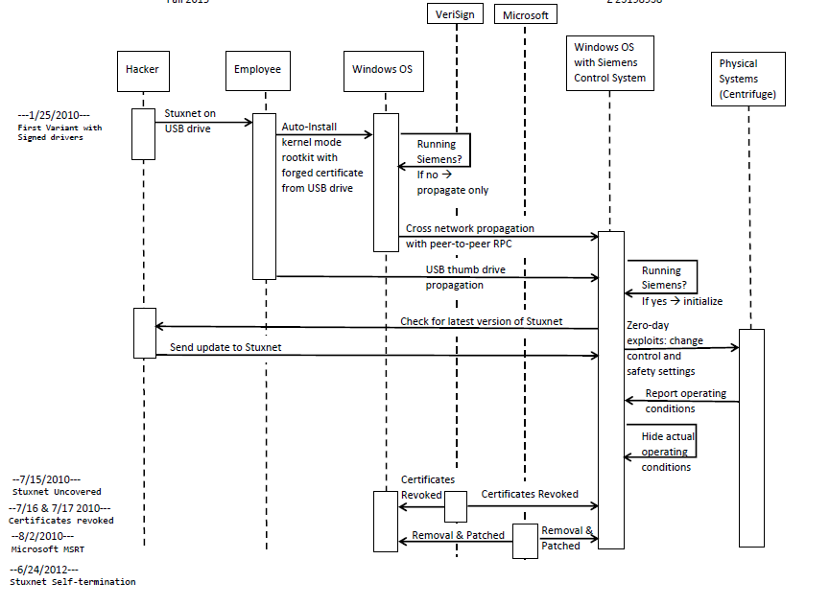

Slide 66
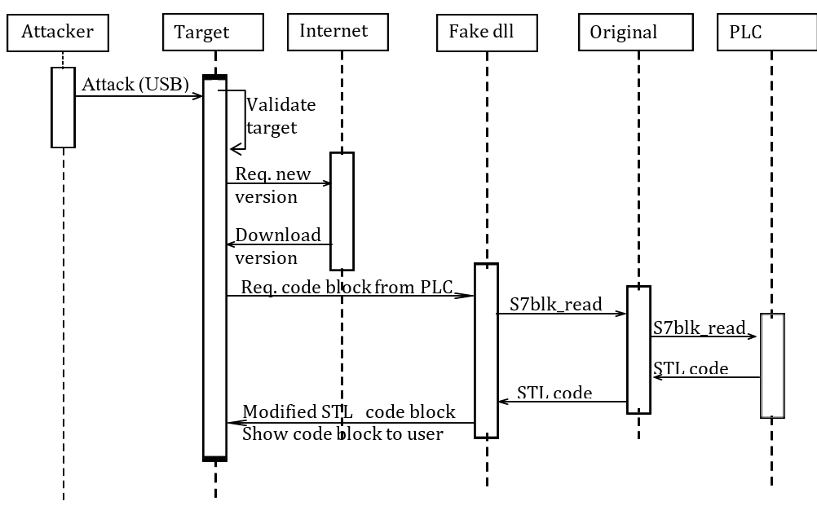
Another good solution

Slide 67
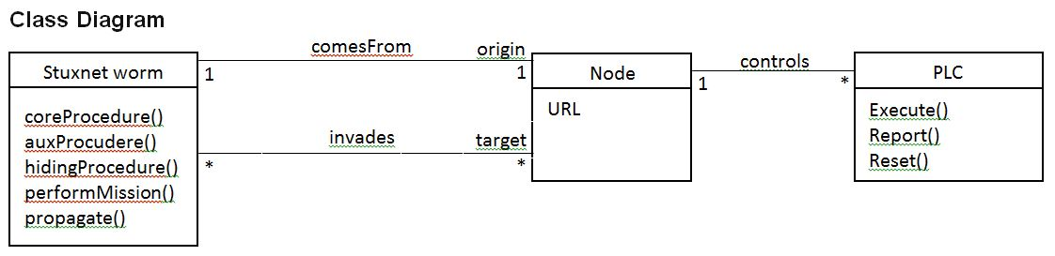
Class diagram

Slide 68
Known uses: Children of Stuxnet
Duqu--On 1 September 2011, a new worm was found, thought to be related to Stuxnet. The Laboratory of Cryptography and System Security (CrySyS) of the Budapest University of Technology and Economics analyzed the malware, naming the threat Duqu. Symantec, based on this report, continued the analysis of the threat, calling it "nearly identical to Stuxnet, but with a completely different purpose", and published a detailed technical paper. The main component used in Duqu is designed to capture info such as keystrokes and system informationn
In May 2012, the new malware "Flame" was found, thought to be related to Stuxnet.^{[124]} Researchers named the program "Flame" after the name of one of its modules.^{[124]} After analysing the code of Flame, Kaspersky said that there is a strong relationship between Flame and Stuxnet. An early version of Stuxnet contained code to propagate infections via USB drives that is nearly identical to a Flame module that exploits the same vulnerability
Instances in Iran and North Korea

Slide 69
2. Define a relational database (a few tables) for the Travel agency of Assignment 1 and write the 8 authorization rules as SQL Authorization rules.
Create Tables:
Customers
Account
Reservation
Employee
Department
Create Roles:
Customer
Travel Agent
Travel Manager
Secretary
Account Employee
Create Authorization Rules
Customer can read own reservation.
Customer can cancel own reservation.
Customer can close own Account.
Travel Agent assemble own or customer’s Reservation
Travel Manager assigns Agent to Customers
Travel manager hire/fire/promote/ Travel Agent
Secretary read/write Customer’s Information
Account Employee bills Customer

Slide 70
CREATE TABLE CUSTOMER
(FNAME VARCHAR(15) NOT NULL,
LNAME VARCHAR(15) NOT NULL,
ID CHAR(9) NOT NULL,
ACTIVE CHAR NOT NULL,
ADDRESS VARCHAR(30) NOT NULL,
ANO INT,
PRIMARY KEY (ID),
FOREIGN KEY (ANO) REFERENCES EMPLOYEES(EID) );
etc…
Travel Agency Defined Roles:
CLIENT, AGENT, MANAGER, SECRETARY, ACCTEMPLOYEE
Travel Agency Hierarchies:
GRANT AGENT TO MANAGER
GRANT SECRETARY TO MANAGER
Travel Agency Views:
VIEW_RES – view created to give customer view of their own reservation
VIEW_ACCOUNT – view created to give customer view of their own account
VIEW_AGENTS – view created to give managers a list of their agents
VIEW_PACKAGES – view created to give list of all travel packages
VIEW_BILLING – view created to list all clients and their current bill of not-cancelled reservations
VIEW_CLIENTS – view created to list all active client accounts

Slide 71
Authorization Rules:
1. – A customer can look at her own reservations or travel plans (already paid)
GRANT SELECT ON VIEW_RES TO CLIENT
2. – A customer can cancel her own reservations
GRANT UPDATE ON VIEW_RES TO CLIENT
3. – A customer can close her account
GRANT SELECT ON VIEW_ACCOUNT TO CLIENT
GRANT UPDATE ON VIEW_ACCOUNT TO CLIENT
4. – Travel Agents can assemble travel packages for their customers
GRANT SELECT ON VIEW_PACKAGES TO AGENT
GRANT INSERT ON VIEW_PACKAGES TO AGENT
5. – Travel Managers can assign agents to customers
GRANT UPDATE ON VIEW_CLIENTS TO MANAGER
6. – Travel Managers can hire, fire, or promote travel agents
GRANT UPDATE ON VIEW_AGENTS TO MANAGER
GRANT INSERT ON VIEW_AGENTS TO MANAGER
7. – Secretaries can read or write client information
GRANT SELECT ON VIEW_CLIENTS TO SECRETARY
GRANT UPDATE ON VIEW_CLIENTS TO SECRETARY
8. – Account Employees can bill customers
GRANT SELECT ON VIEW_BILLING TO ACCTEMPLOYEE
GRANT UPDATE ON VIEW_BILLING TO ACCTEMPLOYEE

Slide 72
3. Summarize the main points of 3GPP LTE security. Give references.
SIM Cards and UICC tokens:
3GGP TS 33.401 - 6.1.1: Access to E-UTRAN with a 2G SIM or a SIM application on a UICC shall not be granted.
Hardware storage location for sensitive information
Limited access to the UICC via a restricted API
Performs cryptographic operations for authentication
Device and network authentication
3GPP TS 33.401 - 6.1.1: EPS AKA is the authentication and key agreement procedure that shall be used over E-UTRAN.
Authentication and Key Agreement (AKA) is the protocol used for devices to authenticate with the carrier and gain network access.
Cryptographic keys needed to encrypts calls are generated upon completion of the AKA protocol.
Mutual Authentication between UE and network
Air Interface Protection
3GPP 33.401- 5.1.3.1: User plane confidentiality protection shall be done at PDCP layer and is an operator option.
Three algorithms exits to protect the LTE air interface:
SNOW 3G
AES
ZUC
Each algorithm can be used for confidentiality protection, integrity protection or to protect both
Mandatory integrity protection for RRC and NAS, and optional for UP
Backhaul Protection
3GPP TS 33.401 - 13:In case the S1 management plane interfaces are trusted (e.g.physically protected), the use of protection based on IPsec/IKEv2 or equivalent mechanisms is not needed.
Confidentiality protection of traffic running over S1 interface (Backhaul)
Hardware security appliances are used to implement this standard.
Security Gateways (SEG)
IPSEC tunnel created between eNodeB and SEG.

Slide 73
UE: User equipment, cellular device
IMEI: Equipment Identifier
3GPP: 3rd Generation Partnership Project
E-UTRAN: Evolved Universal Terrestrial Radio Access Network, mesh network of eNodeBs
eNodeB: Evolved Node B, radio component of LTE network
UICC: Universal Integrated Circuit Card, Sim Card
PDCP Layer: Packet Data Convergence Protocol
LTE: Long Term Evolution
References:
https://www.rsaconference.com/writable/presentations/file_upload/tech-r03_lte-security-how-good-is-it.pdf
https://niksun.com/presentations/day2/NIKSUN_WWSMC_July26_AnandRPrasad.pdf

Slide 74
Final exam (old)
We decided to migrate our travel agency to the cloud using SaaS, including all our data about employees and customers. This service will be rented from a service provider (SP) such as Amazon who provides a set of security functions in its IaaS. Our travel company has several offices in different cities and our customers make reservations in person and online.
We will store our relational database in the cloud where we will have tables such as Customer, Reservation, Travel Entity (Flight, Hotel, Car,…), Payment, Employee, …
Travel services will allow customers to reserve individual flights, hotel rooms, and cars, as well as to assemble packages of services, modify or cancel them, pay for them, etc. Employee services will let employees assemble packages for their customers, managers to assign travel advisors to customers, account employees to send bills to customers,…
Select security services based on the requirements and general security considerations. Be as complete as possible.
Indicate which of these security services you would need from the SP and what security mechanisms you need to add to them to have a secure travel application.
If we implement the user functions as XML web services, what standards would we need to use for security?
Indicate the value of the PaaS facilities for the security of the travel agency.
Make explicit and reasonable assumptions for aspects no specified in detail. Be concise, verbose descriptions will be penalized.

Slide 75
Network World
At a time when cyberattacks on America's critical infrastructure have increased 17-fold (between 2009 and 2011), the need for highly trained cybersecurity professionals is acute.
However, 83% of federal hiring managers in a recent survey said it was extremely difficult to find well-trained cybersecurity professionals and a projected shortfall of 20,000 to more than 40,000 people is expected in the years to come.
The National Security Agency (NSA) is doing something about this cyberskills gap by partnering with the nation's service academies, colleges and universities to foster the growth of the world's most advanced cybersecurity professionals.

Slide 76
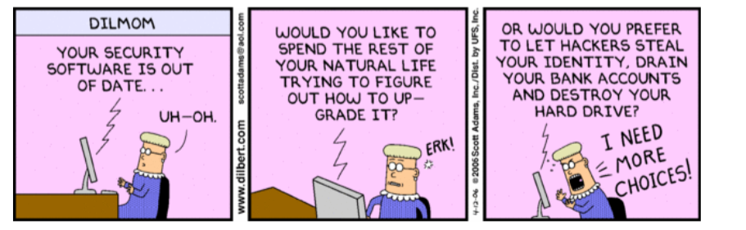

Slide 77
Conclusions I
Internet-based systems are very flexible, but also very complex and changing (getting more complex)
Complexity brings vulnerability
Security must be defined at the high levels and mapped to low levels
Need to have a unified view of security to consider combinations of actions and to present simpler user interfaces (usability)

Slide 78
Conclusions II
It is not easy to design coordinated and holistic security mechanisms
Use of OO and patterns is a promising way for designing secure systems
There are also non-technical problems: social engineering, lack of understanding, poor management, no training

